Slide 1
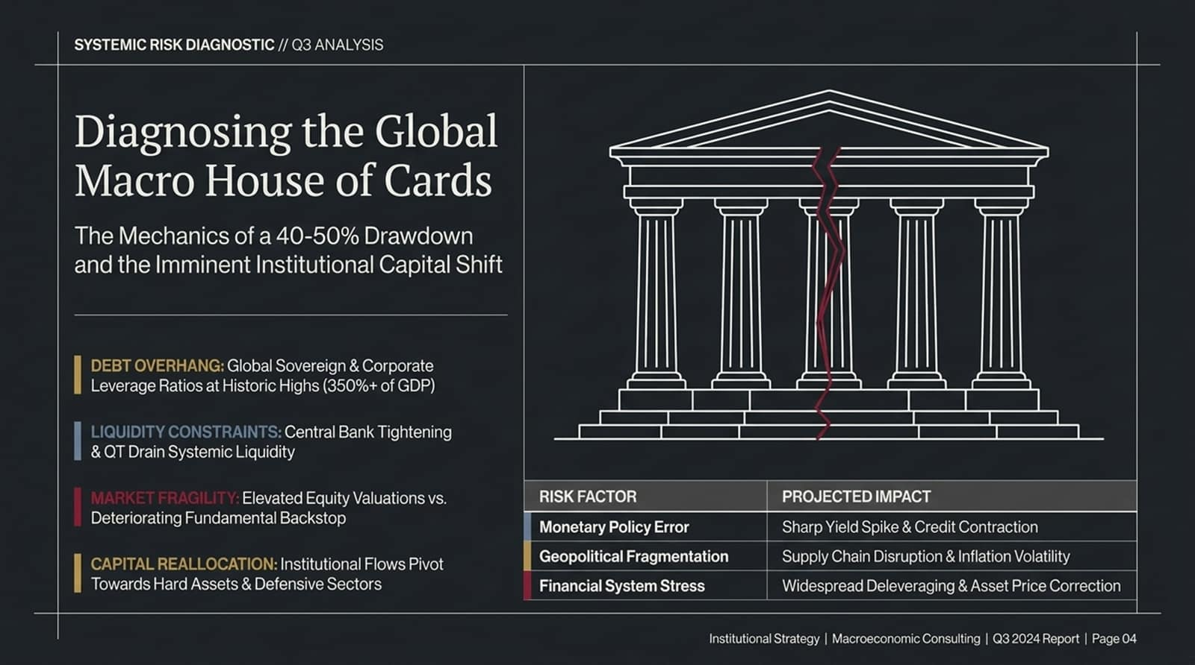
Notes:
Good morning, everyone. Welcome to our Q3 Macroeconomic Diagnostic Presentation.
Today, we are laying out a rigorous, data-driven analysis of what we view as an increasingly precarious macro environment—a literal "Global Macro House of Cards."
As institutional allocators, our primary mandate is capital preservation and tactical positioning ahead of major structural regime shifts. Right now, market pricing reflects widespread complacency. Equity markets have been bidding up mega-cap tech and AI infrastructure to extreme valuation multiples. However, beneath the surface, the real economy is fracturing.
We are projecting a 40% to 50% drawdown in major equity indices over the coming cycle. This is not an alarmist headline; it is a mathematical outcome driven by four converging structural headwinds:
Debt Overhang: Global sovereign and corporate debt levels stand at historic highs, exceeding 350% of global GDP.
Liquidity Constraints: Ongoing quantitative tightening (QT) and central bank policy rates remain elevated, draining systemic liquidity.
Market Fragility: Sky-high equity valuations have completely decoupled from underlying macroeconomic fundamentals and earnings realities.
Capital Reallocation: Smart money is already shifting out of hyper-growth risk assets and quietly moving into hard assets, long-duration treasuries, and defensive cash buffers.
Over the next hour, we will walk through the mechanical feedback loops driving this drawdown and outline the exact playbook for capital reallocation.
https://www.youtube.com/watch?v=5KYh-RMH2R8

Slide 2
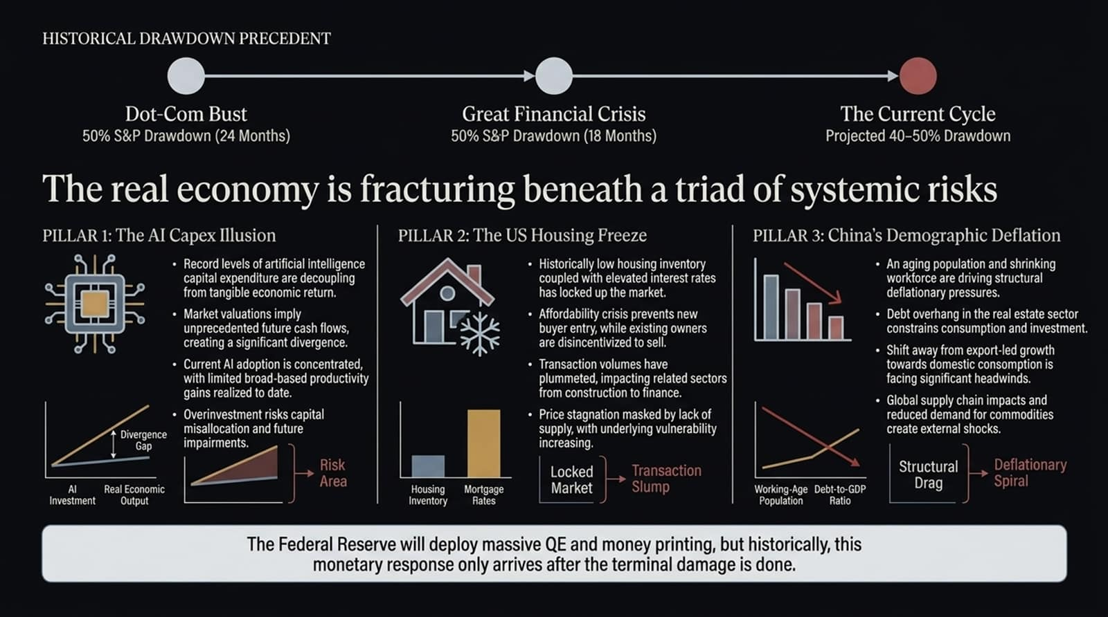
Notes:
To understand where we are going, we must evaluate where we have been.
A 40–50% market drawdown might sound extreme to retail investors, but historical precedent proves it is the standard clearing mechanism when structural leverage unravels:
The 2000 Dot-Com Bust: S&P 500 suffered a 50% drawdown over 24 months as unprofitable tech valuations collapsed.
The 2008 Great Financial Crisis: S&P 500 suffered a 50% drawdown over 18 months, with the bulk of the liquidation occurring rapidly within a 9-month window.
Our current cycle projection matches these historical precedents. Why? Because the real economy is being squeezed by a Triad of Systemic Pillars:
Pillar 1: The AI Capex Illusion: Unprecedented levels of capital expenditure in AI infrastructure are failing to show broad-based productivity gains or end-user monetization, creating a massive divergence gap.
Pillar 2: The US Housing Freeze: Near-record low inventory combined with elevated mortgage rates has completely locked up transaction volumes, stalling 20% of US GDP activity.
Pillar 3: China’s Demographic Deflation: Structural aging, 150 million workers retiring without a safety net, and a real estate collapse are forcing China into a deflationary spiral.
Crucial Takeaway: Do not count on central banks to save risk assets early. Historically, central bank intervention—like Fed rate cuts or QE—arrives after the terminal economic and financial damage has already occurred.

Slide 3
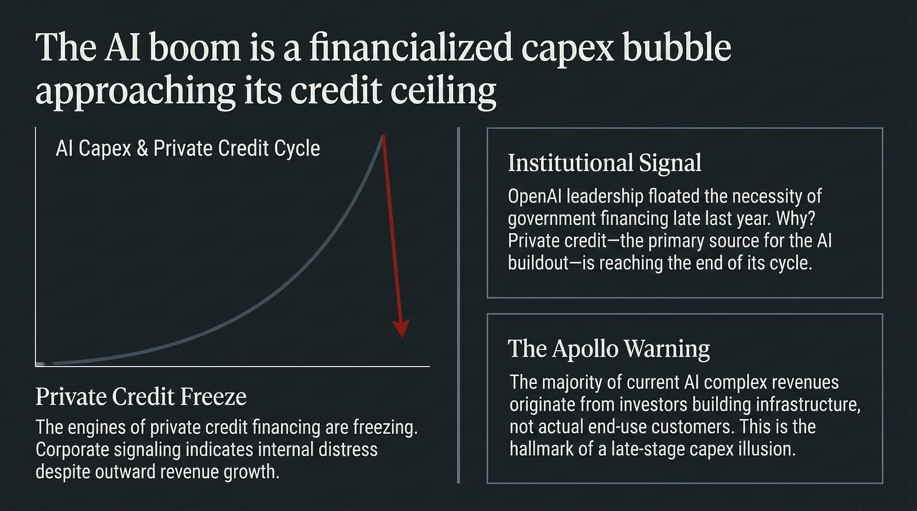
Notes:
Let us dive deep into Pillar 1: The AI Capex Illusion.
The market narrative claims AI is a secular productivity boom. The financial reality is that AI is currently a financialized capex bubble approaching an unforgiving credit ceiling.
Let’s examine three critical institutional signals:
The OpenAI Signal: Late last year, OpenAI leadership—including Sam Altman and CFO Sarah Friar—floated the idea of federal government financing. Why would the world's most hyper-funded tech company ask for government backing? Because the primary private credit engines funding this buildout are reaching the end of their credit cycle.
Private Credit Freeze: Private credit spreads are widening. Corporate signaling shows that despite top-line revenue hype, internal cash-flow stress is mounting.
The Apollo Warning: As highlighted by Apollo Global Management, the vast majority of current revenue generated within the AI ecosystem comes from investors funding infrastructure, not from actual paying end-use customers.
When tech companies trade circular revenue—where Big Tech invests in startups, who then use those funds to buy Big Tech's chips or cloud credits—that is the textbook definition of a late-stage capex illusion.

Slide 4
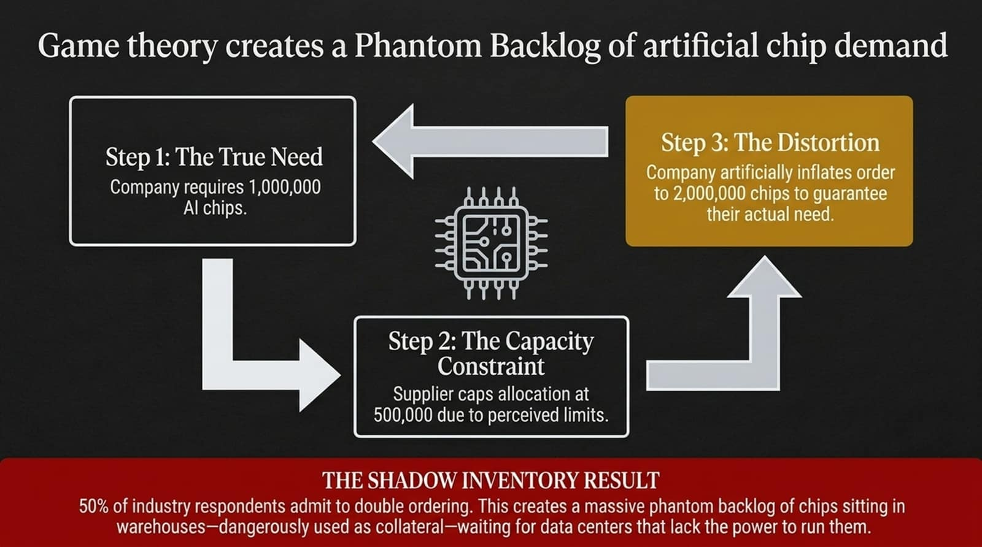
Notes:
How did chip orders get so inflated? The answer lies in classic Game Theory and Supply-Chain Distortion.
During any capex boom where allocation is constrained, double-ordering takes over:
Step 1 (True Need): Company A needs 1,000,000 AI chips to fulfill real operational demand.
Step 2 (Capacity Constraint): The semiconductor supplier informs them that due to supply limits, orders are capped at a 50% allocation—meaning Company A will only get 500,000 chips.
Step 3 (The Distortion): To secure their actual need of 1,000,000 chips, Company A artificially inflates their order to 2,000,000 chips.
The Consequence: Recent industry surveys reveal that 50% of market participants admit to double-ordering. This has created a massive Phantom Backlog.
Chains of chips are sitting in shadow inventory warehouses, often leveraged as collateral in private credit deals. These chips are waiting for data center facilities that, as we will see on the next slide, physically cannot be powered. When these double-orders get canceled, order books will collapse rapidly.

Slide 5
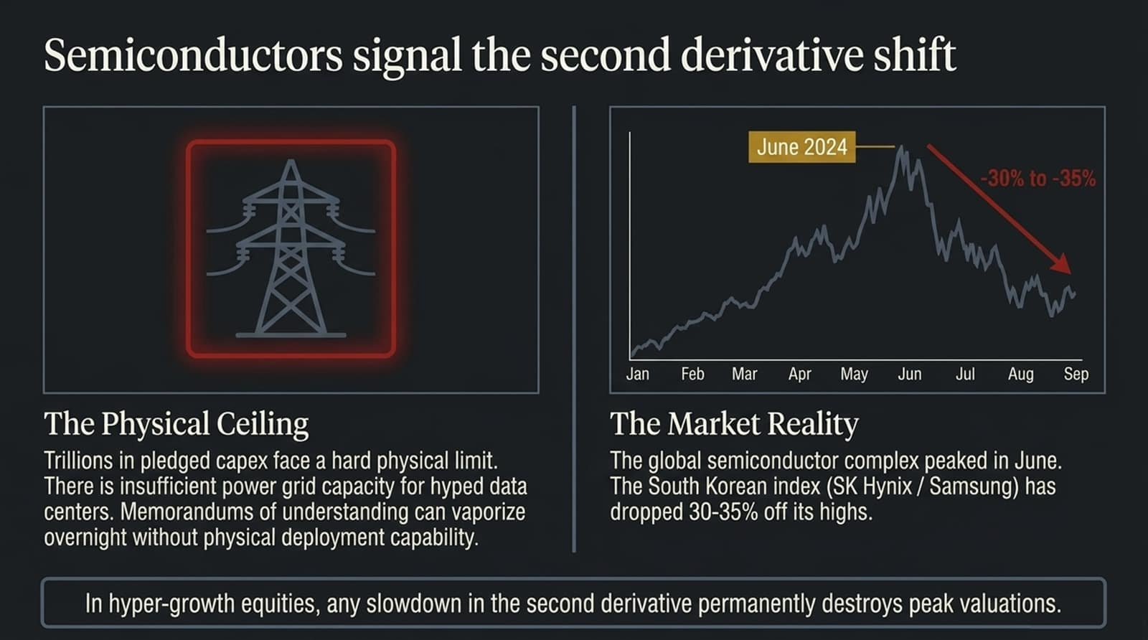
Notes:
The AI buildout faces two immovable brick walls: Physical Grid Capacity and Second Derivative Math.
First, the physical ceiling. Big Tech can pledge hundreds of billions in AI capex, but non-binding Memorandums of Understanding (MOUs) do not equal grid interconnects. Transmission line buildouts take 5 to 10 years. You cannot run gigawatt-scale data centers on vaporware press releases.
Second, look at the market charts on this slide. Semiconductors are the ultimate growth lead indicators.
The global semiconductor complex peaked in June 2024.
Look at South Korea’s benchmark index—heavily weighted towards memory chip leaders SK Hynix and Samsung—it has already dropped 30% to 35% off its summer highs.
In hyper-growth equities, a deceleration in growth rate—the negative second derivative—permanently destroys peak multiples. You do not need capex to drop to zero; you simply need the growth rate to slow down, and market valuations will re-rate downward violently.

Slide 6
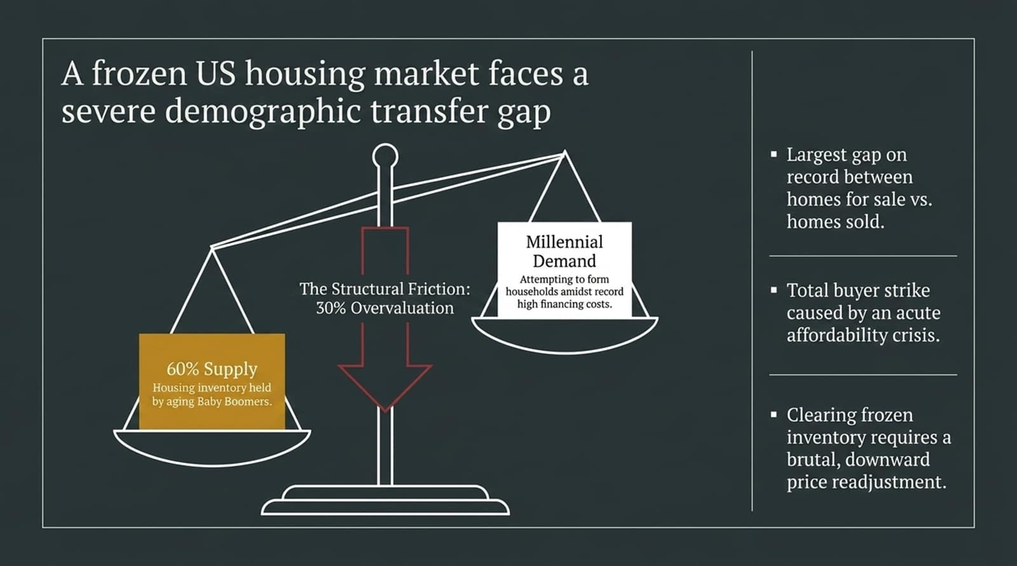
Notes:
Now let us pivot to Pillar 2: The US Housing Freeze.
Housing accounts for approximately 20% of US GDP. Today, the US housing market is experiencing a severe structural freeze caused by a demographic transfer gap:
The Supply Side: Approximately 60% of all owner-occupied housing inventory is held by aging Baby Boomers.
The Demand Side: Millennials attempting to form households are hitting an absolute affordability wall due to high prices and 7%+ mortgage rates.
This has created the largest gap on record between homes listed for sale versus actual homes sold. Buyers are on a complete strike.
Our quantitative modeling indicates that US housing is currently 30% structurally overvalued relative to median incomes and interest rates. Low transaction volume is currently masking price stagnation, but clearing this frozen market will ultimately require a downward price readjustment.

Slide 7
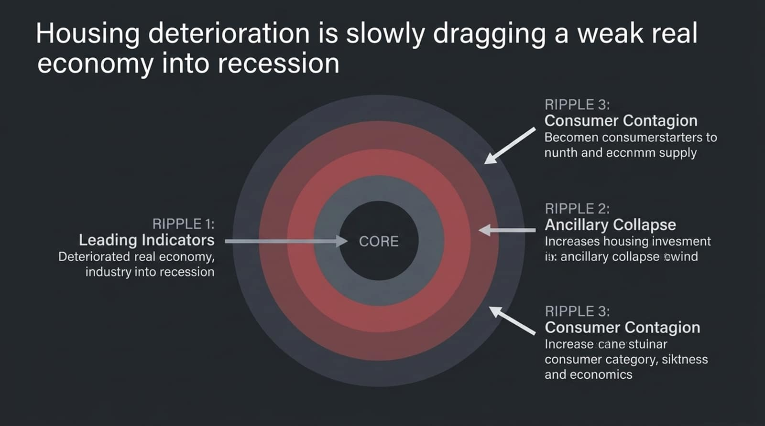
Notes:
Why does a frozen housing market matter for equity markets? Because housing weakness creates a broad-based economic contagion.
Look at the three ripple stages mapped out here:
Ripple 1 (Leading Indicators): The rollover began silently in 2022 when new building permits peaked and turned downward. Construction starts and housing starts continue to soften.
Ripple 2 (Ancillary Collapse): When housing transactions freeze, it dries up spending across the entire real estate matrix—title insurance, mortgage origination, remodeling, furniture, and major appliance sales.
Ripple 3 (Consumer Contagion): Homeowners rely on the "wealth effect" of home equity. As transaction illiquidity translates into price concessions, consumer confidence collapses. We are already seeing earnings reports from mass retailers like Walmart highlighting that lower- and middle-income consumers are under severe budget strain.
Historically, housing spillovers drag the broader economy into a formal recession. By the time real estate price drops hit mainstream media headlines, the recession is already well underway.

Slide 8
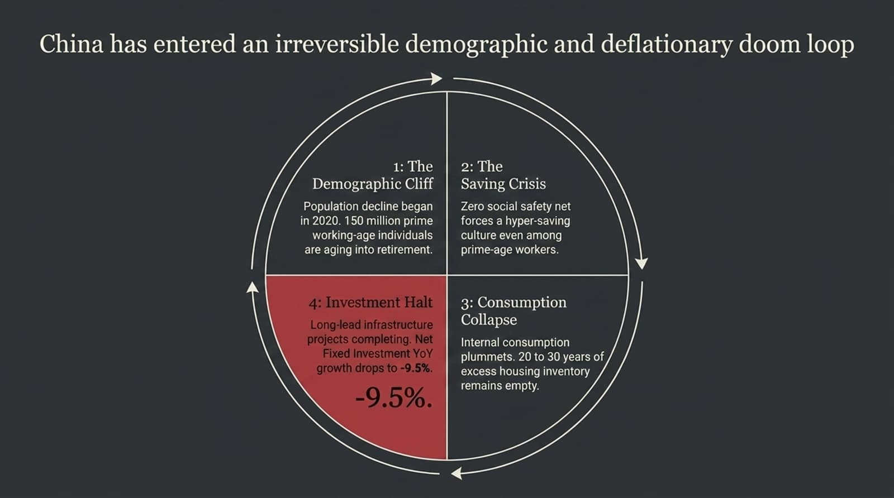
Notes:
Moving to Pillar 3: China's Structural Collapse.
China is not facing a cyclical slowdown; it has entered an irreversible demographic and deflationary doom loop.
Step 1 (Demographic Cliff): China's population began contracting in 2020. Over the current decade, China is losing roughly 150 million prime working-age individuals who are aging out into retirement.
Step 2 (The Savings Crisis): China lacks a comprehensive social safety net or pension buffer. As workers age, citizens enter hyper-saving mode to protect themselves, dragging velocity of money down.
Step 3 (Consumption Collapse): Domestic consumption is plummeting. China sits on 20 to 30 years of vacant, excess residential housing inventory.
Step 4 (Investment Halt): Multi-year state infrastructure projects are finally completing. China’s Net Fixed Investment YoY growth has plunged to -9.5%.
China cannot build its way out of this crisis as it did in 2008. The internal engines of growth are completely exhausted.

Slide 9
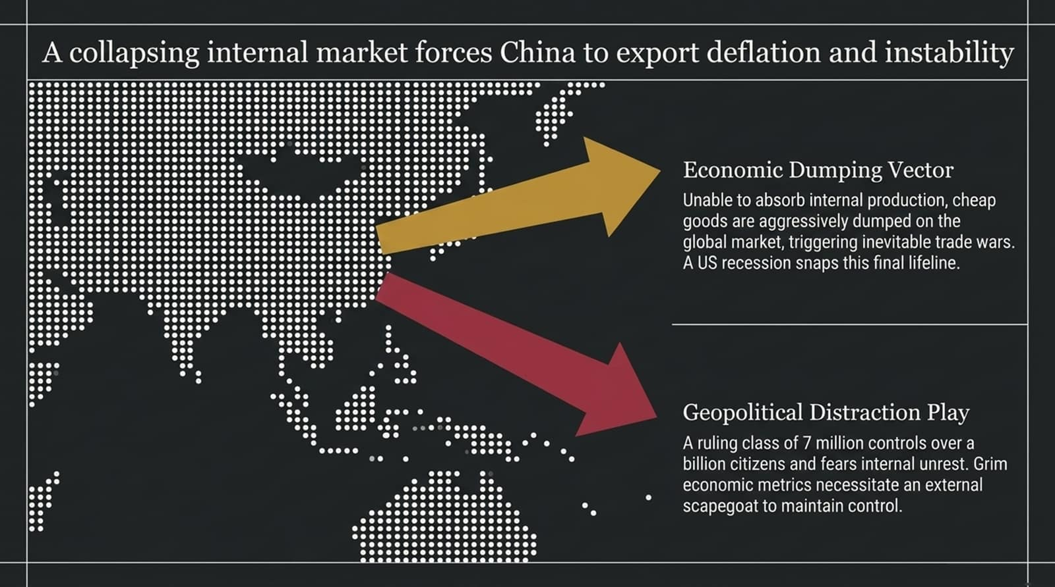
Notes:
Because China's domestic market cannot absorb its industrial output, Beijing is attempting to export its way out of deflation.
This creates two global contagion vectors:
Economic Dumping: China is flooding international markets with heavily subsidized, low-cost manufactured goods and clean tech. This is triggering global trade friction and protectionism across Europe and North America. However, if the US enters a domestic recession, global import demand will collapse, severing China's last remaining lifeline.
Geopolitical Distraction Play: The Chinese Communist Party leadership consists of roughly 7 million elite party members governing over 1.4 billion citizens. Historical analysis shows that autocratic regimes facing severe domestic economic breakdown frequently turn to external geopolitical flashpoints—such as Taiwan—to divert internal public unrest.

Slide 10
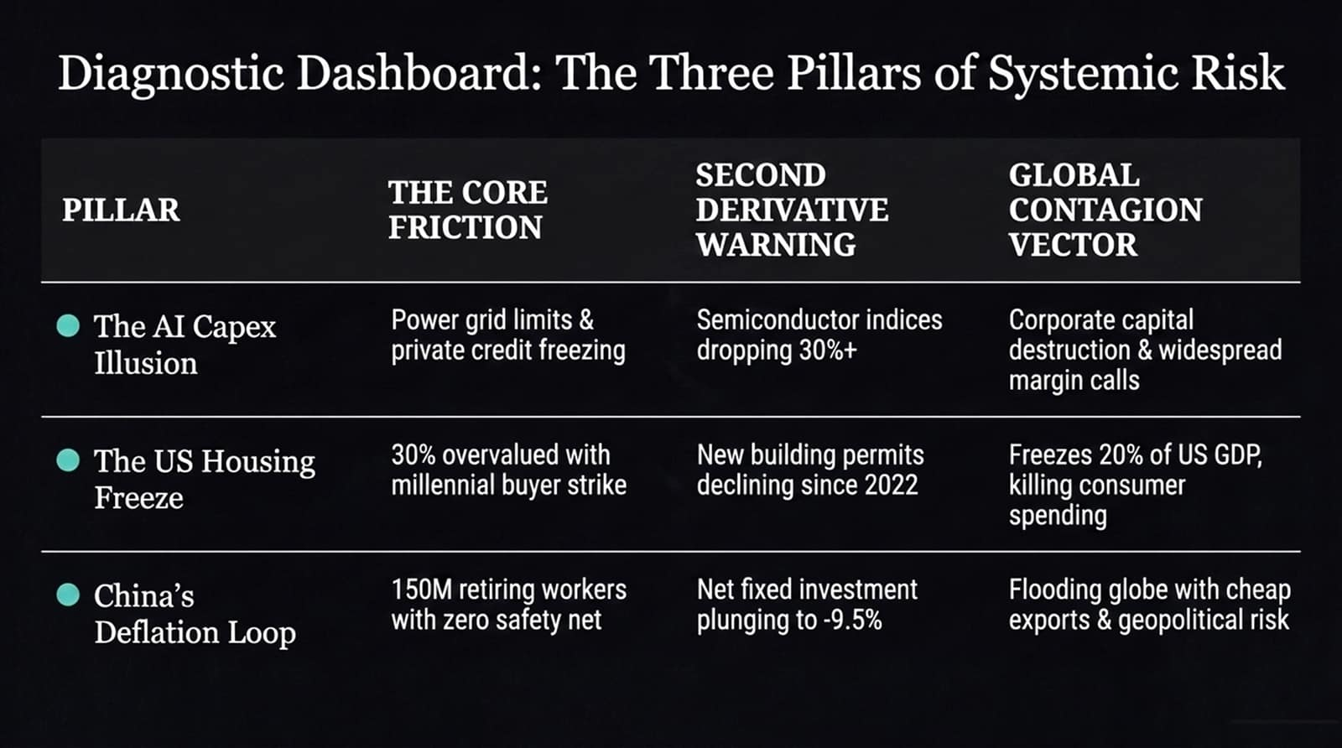
Notes:
This dashboard summarizes our core macro diagnostic. It aligns our three pillars across their core frictions, real-time lead warnings, and global contagion impacts:
AI Capex Bubble: Core friction is grid limitations and private credit freezing. The second derivative warning is the 30%+ drop in semiconductor indices. The contagion vector will be widespread tech balance sheet impairments and margin calls.
US Housing Freeze: Core friction is 30% overvaluation meeting a buyer strike. The second derivative warning is multi-year declines in building permits. The contagion vector is frozen consumer spending impacting 20% of US GDP.
China Deflation: Core friction is 150M retiring workers without a safety net. The second derivative warning is Net Fixed Investment plunging to -9.5%. The contagion vector is exported deflation, global trade disputes, and heightened geopolitical tail risk.
When these three pillars deteriorate simultaneously, systemic risk reaches critical mass.

Slide 11
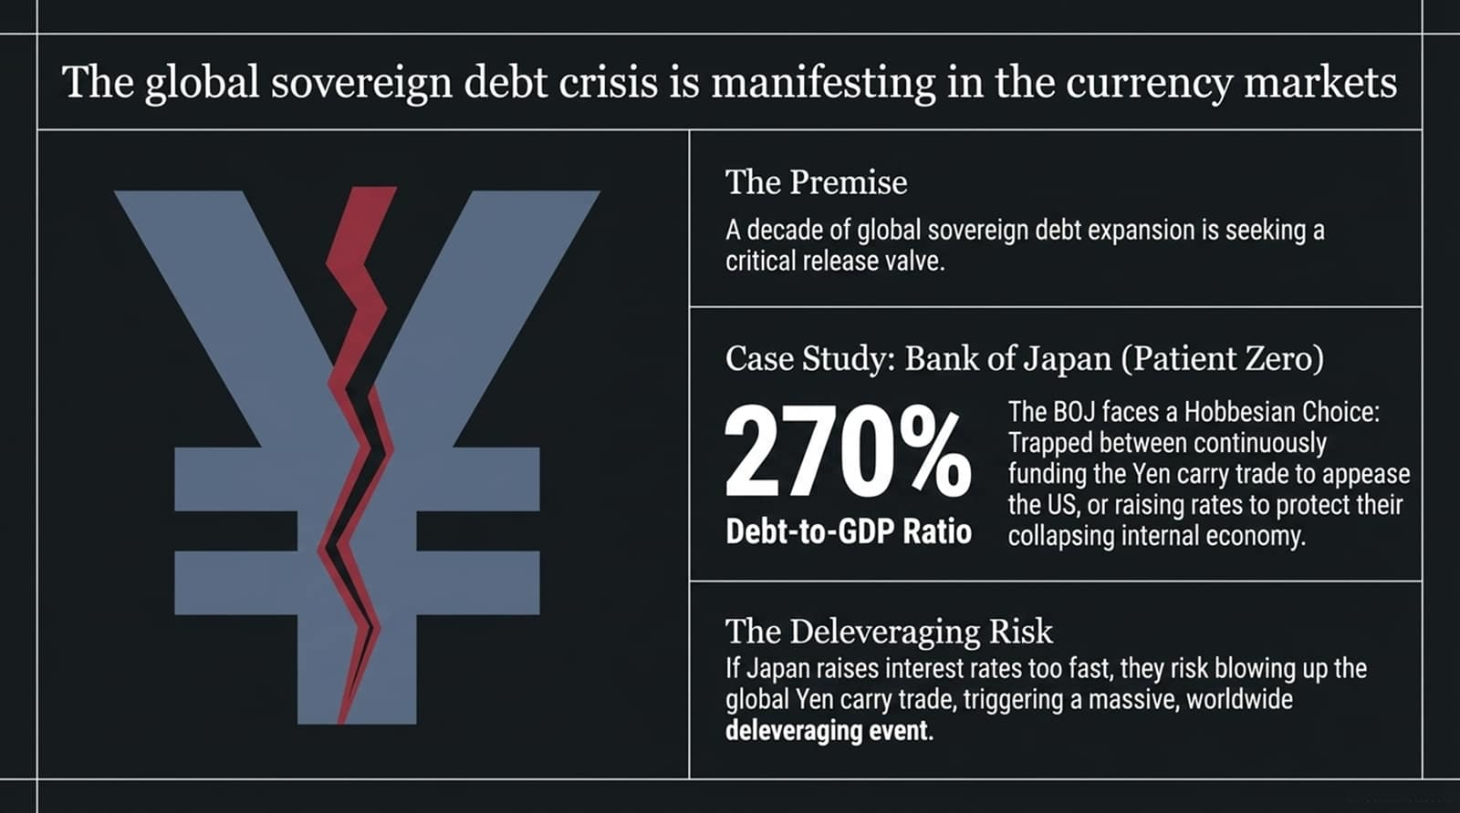
Notes:
Beyond the real economy, sovereign debt markets are approaching a breaking point.
When governments over-issue debt, the pressure must eventually escape through the currency market release valve.
Look at Japan: Sovereign Patient Zero.
Japan holds a national debt-to-GDP ratio exceeding 270%.
The Bank of Japan is trapped in a classic Hobbesian Choice: If they raise interest rates to defend a depreciating Yen, they bankrupt their treasury and spike domestic debt servicing costs. If they keep interest rates suppressed, the Yen collapses.
The Global Risk: Trillions of dollars in global assets are built on the Yen Carry Trade—borrowing cheap Yen to buy higher-yielding global risk assets. Any rapid interest rate hikes by the BOJ force an emergency unwinding of this carry trade, triggering global cross-asset liquidation.

Slide 12
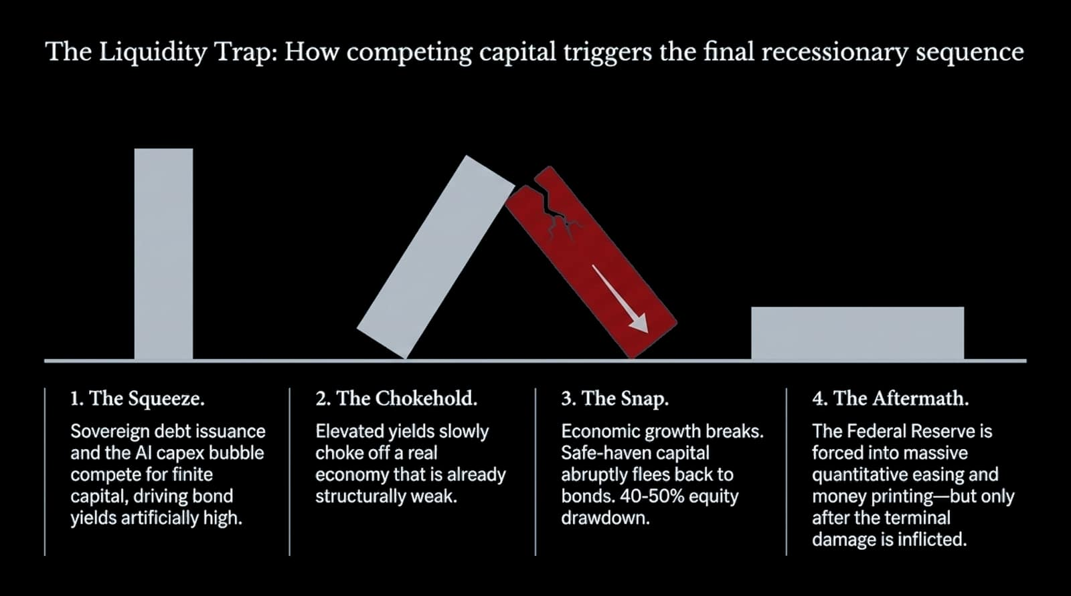
Notes:
This diagram details the step-by-step sequence of how competing capital triggers a market snap:
Step 1 (The Squeeze): Heavy government bond issuance competes directly with AI corporate capex for limited global capital, keeping long-term yields elevated.
Step 2 (The Chokehold): Elevated risk-free yields slowly choke off consumer credit, housing transactions, and small-business refinancing in an already fragile economy.
Step 3 (The Snap): Real economic earnings break. Investors abruptly realize that equities are priced for perfection while growth is contracting. Capital panics, fleeing equity markets into safe-haven bonds—driving the 40% to 50% equity drawdown.
Step 4 (The Aftermath): Central banks intervene with aggressive rate cuts and massive QE printing, but only after equity valuations have been reset.

Slide 13
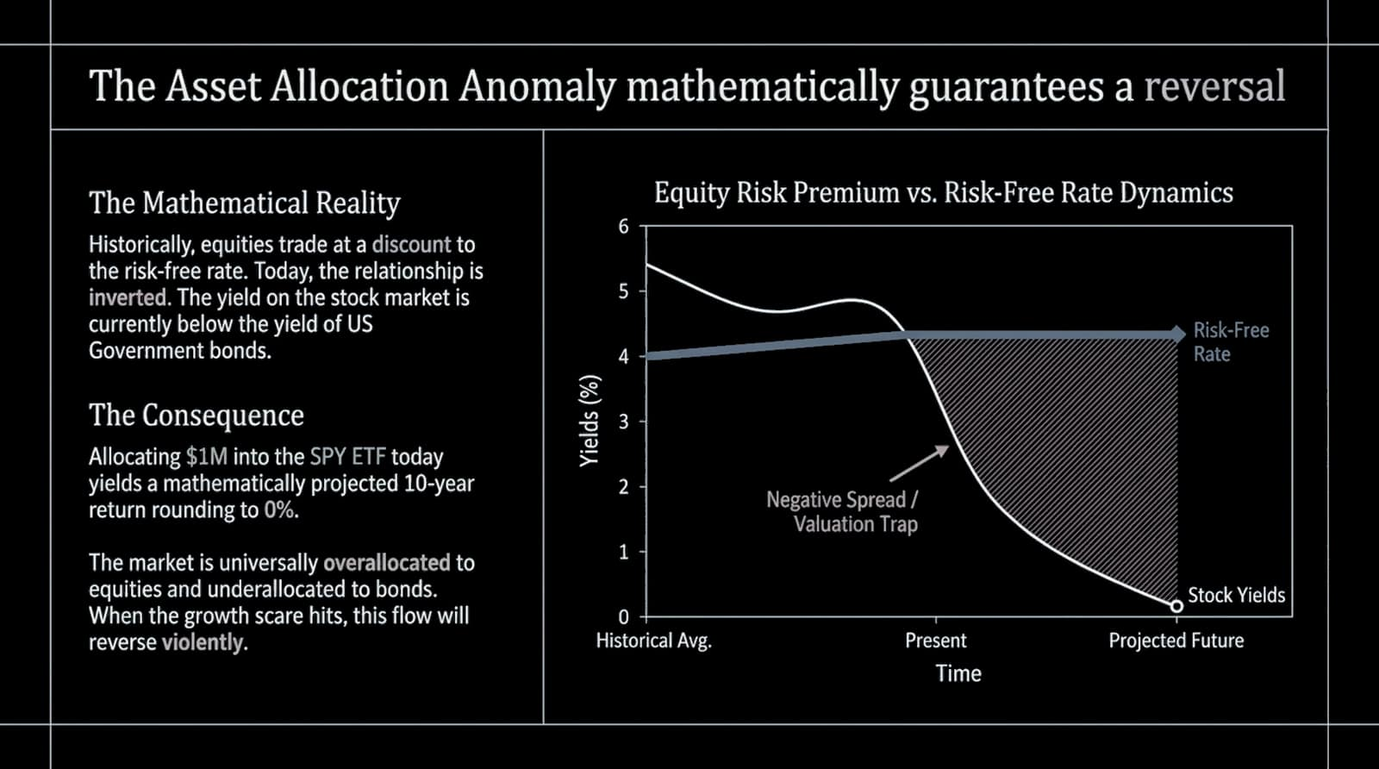
Notes:
Slide 13 contains the most compelling mathematical proof of equity market risk: The Asset Allocation Anomaly.
Historically, stock earnings yields trade at a premium above government bonds to compensate investors for taking equity risk. Today, that relationship is completely inverted. The yield on the S&P 500 sits below the risk-free rate of US Treasuries.
The Math: If you invest $1,000,000 into the S&P 500 (SPY) today, forward-looking 10-year valuation models project a real return rounding to 0%.
Institutional and retail portfolios are heavily overallocated to equities and underallocated to fixed income. When growth slows, institutional asset allocation models will mathematically mandate a massive capital rotation out of stocks and into treasuries.

Slide 14
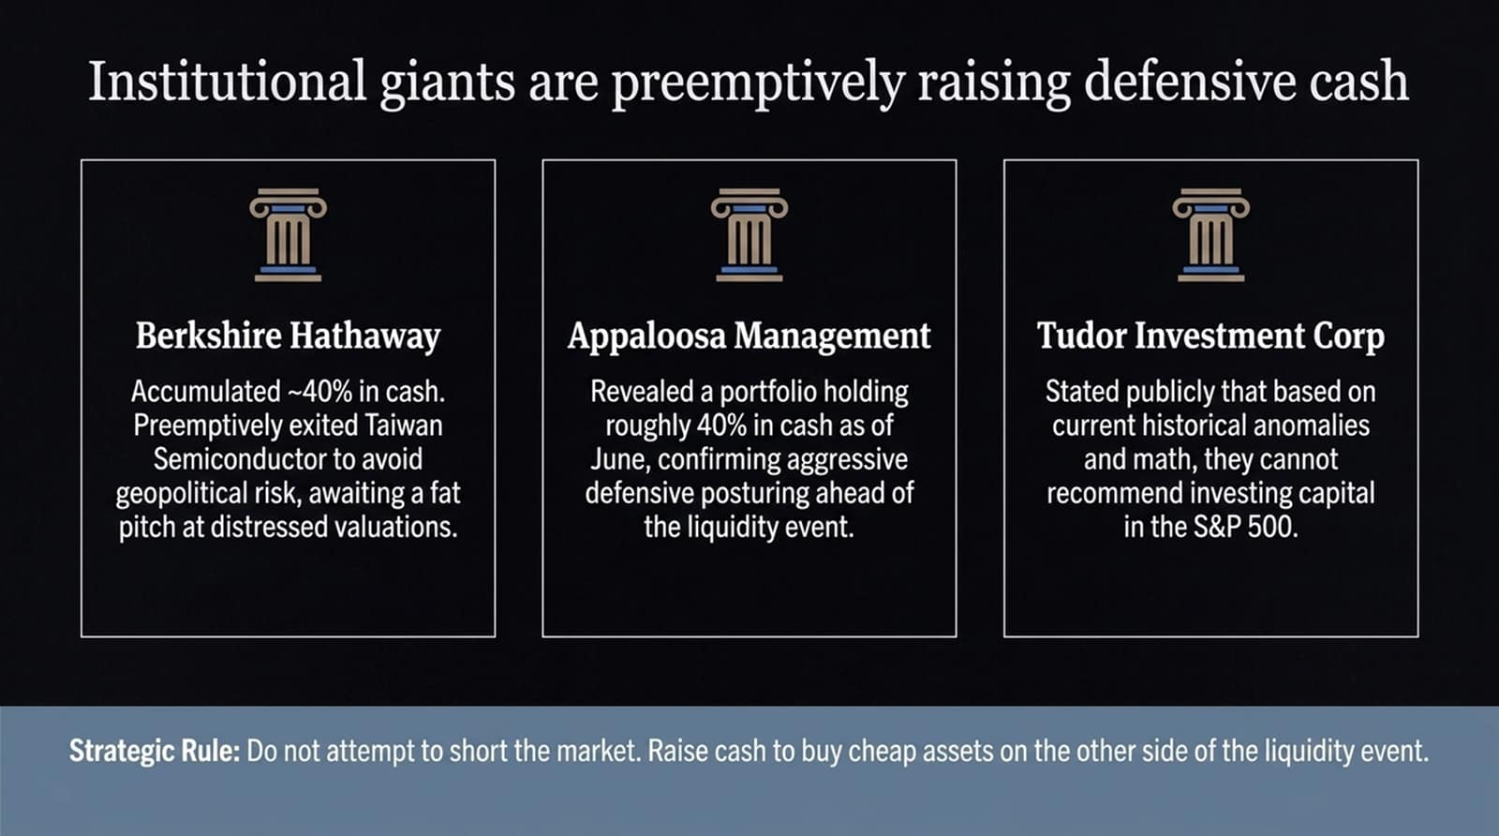
Notes:
Smart money is not waiting for the crash to occur; top institutional allocators are actively positioning for it now:
Berkshire Hathaway (Warren Buffett): Buffett has built a historic cash pile representing ~40% of Berkshire's portfolio. He exited TSMC early to eliminate geopolitical risk and has been selling equities to prepare for distressed asset purchases.
Appaloosa Management (David Tepper): Regulatory filings reveal Tepper held approximately 40% in cash positions, citing extreme equity overvaluation.
Tudor Investment Corp (Paul Tudor Jones): Publicly stated that based on stock-versus-bond risk premia, he cannot justify allocating new capital to the S&P 500 at current levels.
Strategic Rule: Do not try to short a hyper-volatile market. Build cash buffers to buy high-quality assets at distressed prices on the other side of the liquidity shock.

Slide 15
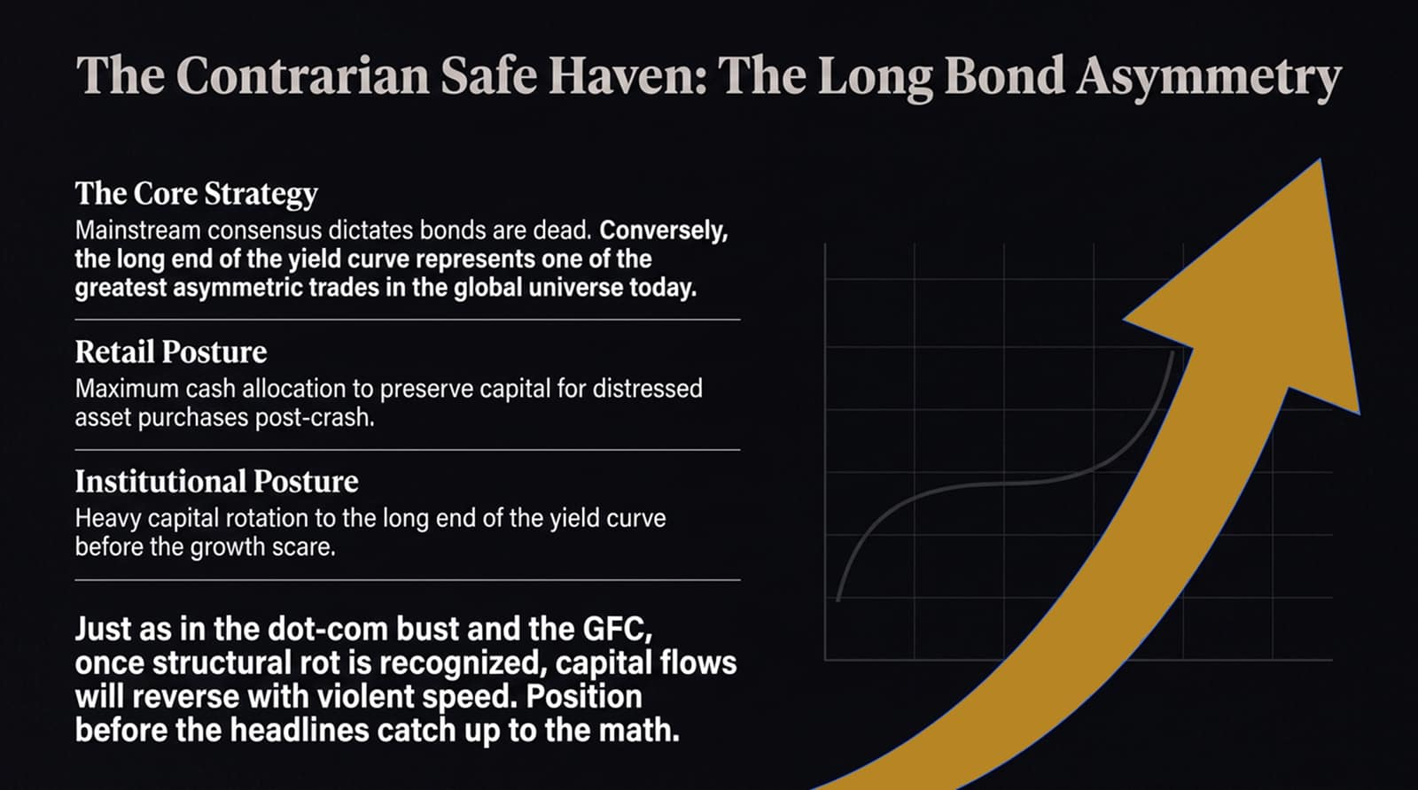
Notes:
While retail sentiment considers bonds "dead," long-duration Treasury bonds represent one of the most asymmetric trade setups in the global landscape.
Let’s contrast market behaviors:
Retail Posture: Holding overpriced equities while keeping cash in low-yielding bank accounts.
Institutional Strategy: Locking in high long-term rates by rotating into the long end of the yield curve before the macro growth scare forces yields down.
When equity markets drop 40–50%, long-duration bond prices surge as capital panics into safe-haven assets. Just as in 2000 and 2008, capital reallocation will happen fast. Positioning must occur before headlines confirm the economic shift.

Slide 16
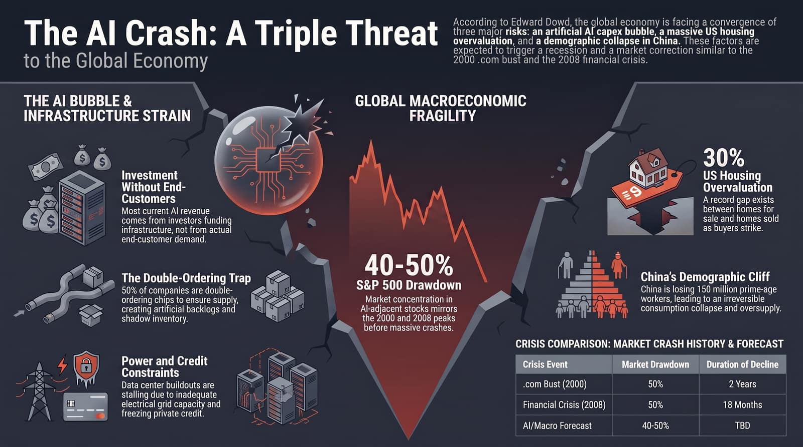
Notes:
To conclude our diagnostic overview, let us summarize the core thesis:
We are facing a rare convergence of three simultaneous structural shocks:
An AI Infrastructure Bubble plagued by double-ordering, credit constraints, and grid bottlenecks.
A Frozen US Housing Market sitting at 30% overvaluation.
China's Demographic Cliff driving global export deflation.
Look at our historical crisis comparison table:
2000 Dot-Com Bust: 50% Drawdown over 2 Years.
2008 Financial Crisis: 50% Drawdown over 18 Months.
Current Macro Forecast: 40%–50% Drawdown Projected.
Actionable Allocation Playbook:
Reduce Equity Risk: Trim tech concentration and overvalued growth equities.
Raise Cash Reserves: Target 30–40% liquidity to deploy into distressed assets post-crash.
Secure Long Duration: Accumulate long-term Treasuries as an asymmetric hedge.
Thank you. I will now open the floor to questions.

